Slide 1
Business Intelligence Overview

Slide 2
Introduction to Business Intelligence
The Decision Making Process
Data, Information,knowledge,decision making-Action cycle
Business Intelligence-overview
Business Intelligence-Definition
Business Intelligence Process
Business Intelligence Components
Business Intelligence Layers

Slide 3
Equipping the Organization for Effective Decision Making and Decision-Making Process

Slide 4
Introduction
Decision making is a daily activity for any human being.
When it comes to business organizations, decision making is a habit and a process as well.
Effective and successful decisions make profit to the company and unsuccessful ones make losses.
Therefore, corporate decision making process is the most critical process in any organization.

Slide 5
Introduction cont’
In the decision-making process, we choose one course of action from a few possible alternatives.
In the process of decision making, we may use many tools, techniques and perceptions.
In addition, we may make our own private decisions or may prefer a collective decision.
Usually, decision making is hard.
Majority of corporate decisions involve some level of dissatisfaction or conflict with another party.

Slide 6
Introduction cont’
Decision making can be regarded as the mental processes resulting in the selection of a course of action among several alternatives.
Every decision-making process produces a final choice.
The output can be an action or an opinion of choice.

Slide 7
Definition:
In general:
Decision making is the process of making choices by identifying a decision, gathering information, and assessing alternative resolutions.
Using a step-by-step decision-making process can help you make more deliberate, thoughtful decisions by organizing relevant information and dening alternatives.
This approach increases the chances that you will choose the most satisfying alternative possible.

Slide 8
Definition cont’
Decision :
Making a choice from two or more alternative.
Decision Making:
The process of examining your possibilities and options, comparing them, and choosing a course of action.

Slide 9
Decision Making Process
There are 8 steps of Decision Making:
Identification of problem
Identification of decision Criteria
Allocating weight to criteria
Develop alternatives
Analysis of Alternatives
Selection of alternatives
Implementation of the best alternatives
Evaluation of decision effectiveness

Slide 10

Step1: Identifying The Problem
A problem is defined as a discrepancy between an existing and a desired state of affairs.
Some cautions about problem identification include the following:
  1.Make sure it’s a problem and not just a symptom of a problem.
  2.Problem identification is subjective.
  3.Discrepancies can be found by comparing current results with some standard.
  4.Managers aren’t likely to characterize a discrepancy as a problem if they perceive that they don’t have the authority, information, or other resources needed to act on it.

Slide 11
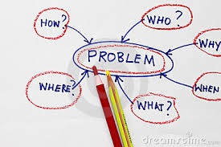
Identifying The Problem

Slide 12
Step2: Identifying Decision Criteria
Decision criteria are factors that are Important (relevant) to Resolving the problem.
  Costs that will be incurred(investment required)
  Risk likely to be encountered( chance of failure)
  Outcomes that are desired (growth of the firm)

Slide 13

Step3: Allocating Weights to the Criteria
Decision criteria are not of equal importance:
  Assigning a weight to each item places the items in the correct priority order of their importance in the decision making.
Each possible solution must have features or cons and pros.
A manager should score the criteria according to the need of the situation.

Slide 14

Step4: developing Alternatives
As manager it is advised you select a viable alternative that could also resolve the problem.
At this point we are just listing not evaluating the alternatives.

Slide 15

Step5: Analyzing Alternatives
Appraising each alternative strengths and weaknesses
  An alternative’s appraisal is based on its ability to resolve the issues identified in steps 2 and 3.

Slide 16

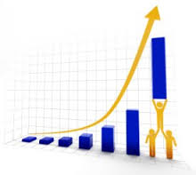
Step6: Selecting Alternatives
  Choosing the best alternative or the one that scored the highest total in step 5.

Slide 17
Step 7: Implementing the Decision
Putting the decision into action by conveying into those affected and getting their commitment to it.

Slide 18

Step8: Evaluating the Decision’s Effectiveness
Evaluating the outcome or result of the decision to see if the problem was resolved.
If the problem still persists, the managers should re-assess the problem and start over again.

Slide 19
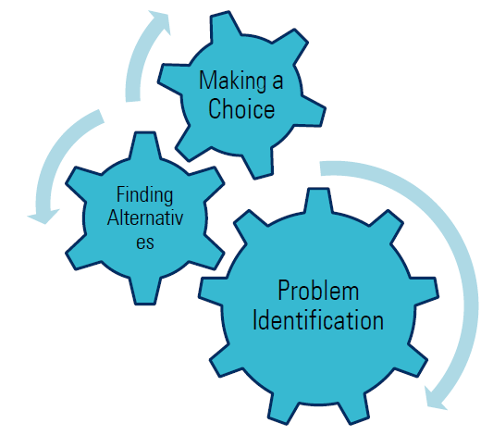
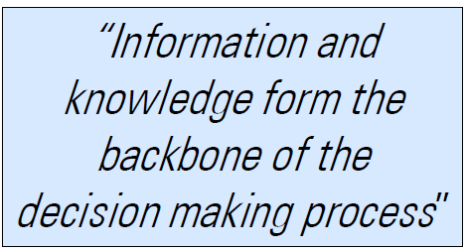
Fig.1:Summary of Decision making steps
Decision making steps include
– Problem identification,
– Finding alternative solutions,
– Making a choice

Slide 20
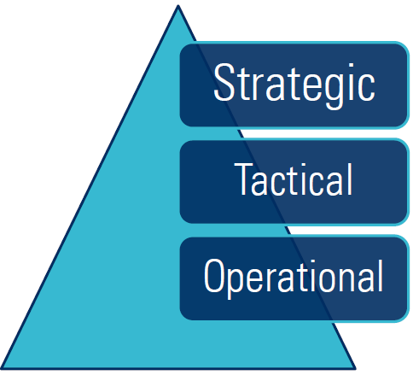
Who Makes Decisions?
Decision making at different levels:
– Operational
• Related to daily activities with short-term effect
• Structured decisions taken by lower management
– Tactical
• Semi-structured decisions taken by middle management
– Strategic
• Long-term effect
• Unstructured decisions taken by top management
Fig.2:Who makes Decisions

Slide 21
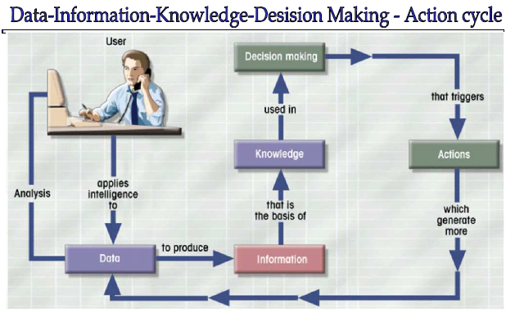
Fig.3:Action cycle of Decision making

Slide 22
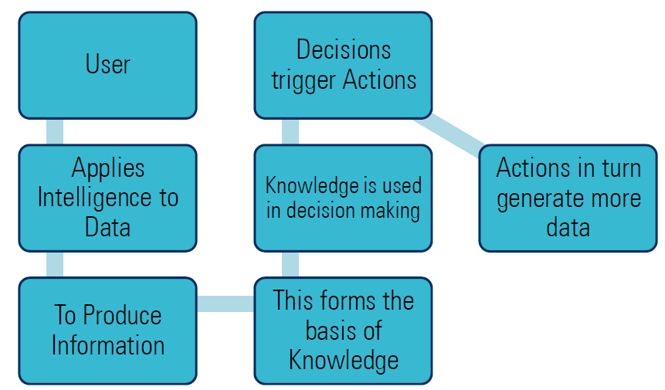
Explanation:

Slide 23
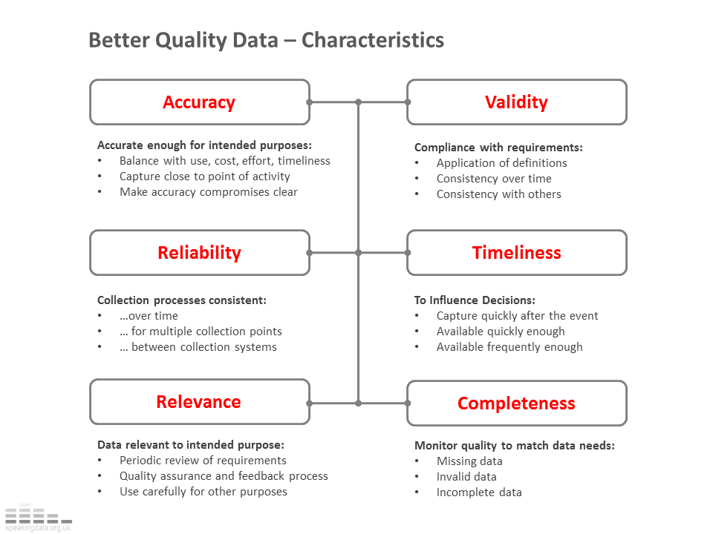
Characteristics of Data for Good Decision Making

Slide 24
Conclusion
When it comes to making decisions, one should always weigh the positive and negative business consequences and should favor the positive outcomes.
This avoids the possible losses to the organization and keeps the company running with a sustained growth.
But, making the decisions and accepting its consequences is the only way to stay in control of your corporate life and time.

Slide 25
Business Intelligence
Overview & introduction

Slide 26
Business Analytics, BI, Big Data, Data Mining - What’s the difference?
Business Analytics – Tools to explore past data to gain insight into future business decisions.
BI – Tools and techniques to turn data into meaningful information.
Big Data –data sets that are so large or complex that traditional data processing applications are inadequate.
Data Mining - Tools for discovering patterns in large data sets.

Slide 27
Overview of Business Intelligence
Analytical tools
Data
Sources
Data
Warehouse
Analysis
Results
OLAP
Data Mining
Data visualisation
Data visualisation
Fig.4:BI Overview

Slide 28
What is Business Intelligence?
There are many definitions of Business Intelligence as below, each definition raises a prominent characteristic of BI yet the general rules are all mentioned the possibility of helping to make efficiency decision of Business Intelligence.

Slide 29
Collecting and refining information from many sources (internal and external)
Analyzing and presenting the information in useful ways (dashboards, visualizations)
So that people can make better decisions
That help build and retain competitive advantage.

Slide 30
Business Intelligence (BI) refers to skills, processes, technologies, applications and practices used to support decision making.
Business intelligence - BI is the set of theories, methodologies, architectures and techniques and tools for the transformation of raw data into meaningful and useful information for business Analysis purposes.
BI is the applications and technologies transforming Business Data into Action.
BI is the new technology for understanding the past & predicting the future.

Slide 31
Summary on BI definition:
BI refers to computer-based techniques used in spotting, digging-out, and analyzing business data, such as sales revenue by products and/or departments or associated costs and incomes.
BI technologies provide historical, current, and predictive views of business operations.
Business Intelligence often aims to support better business decision-making.

Slide 32
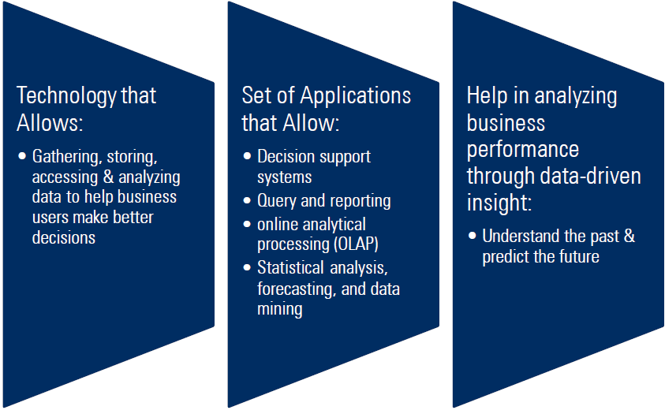
Fig.4:BI Definition

Slide 33
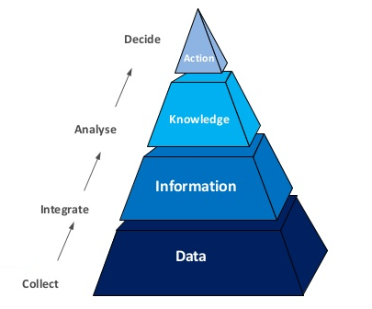
BI is a process and technology that enterprises use to control the huge number of data, mining data to make the decision- making more efficient in their business activity.
The target of BI is to help enterprises make better decision
BI technology provides an overview on activities of enterprises from the past, present to future predictions.
Therefore, BI system is also known as Decision Support System (DSS).

Slide 34
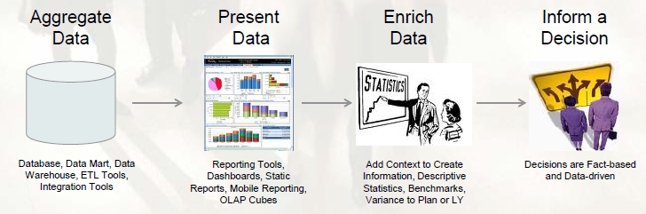
Business Intelligence enables the business to make intelligent, fact-based decisions.

Slide 35
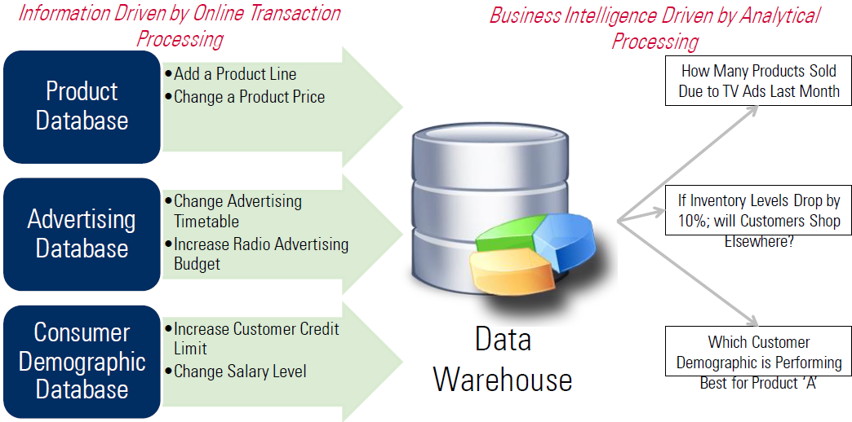
Fig.6:BI Example

Slide 36
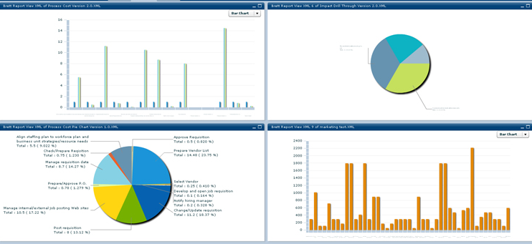
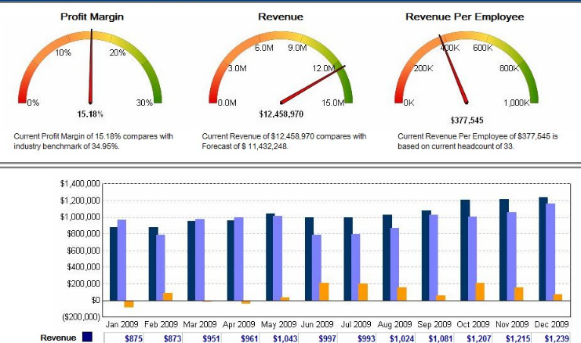
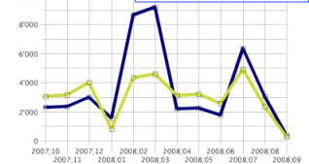
Reports
Data repository
Different systems
Fig.6:BI Example Cont’
36

Slide 37
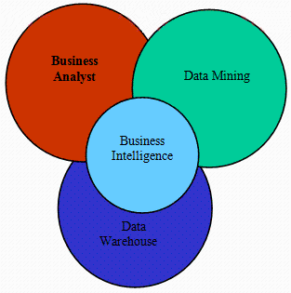
A simple BI system can be viewed as a combination of three main components as follows:
Data Warehouse: contains comprehensive data of the firm.
Data Mining: includes techniques to exploit data and discover information like Classification, Clustering, Association Rule, and Prediction.
Business Analyst: Leaders of enterprises make strategic decisions on activities of the firm.

Slide 38
BI
reporting
data discovery capabilities

Slide 39
BI and analytics
(Gartner, 2014)
Information Delivery
Analysis
Reporting
Interactive visualization
Dashboards
Microsoft Office integration
Search-based data discovery
Ad hoc report/query
Geospatial and location intelligence
Mobile BI
Online analytical processing (OLAP)
Embedded advanced analytics
Data mashup is an integration of two or more data sets in a single graphical interface.
Dashboard is a prime example of a data mashup hard at work – most dashboards pull data from multiple, disparate sources
Integration
BI infrastructure and administration
Collaboration
Metadata management
Business user data mashup and modeling
Embeddable analytics
Development tools
Support for big data sources

Slide 40
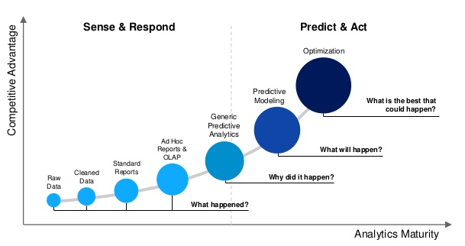
Evolution of BI

Slide 41
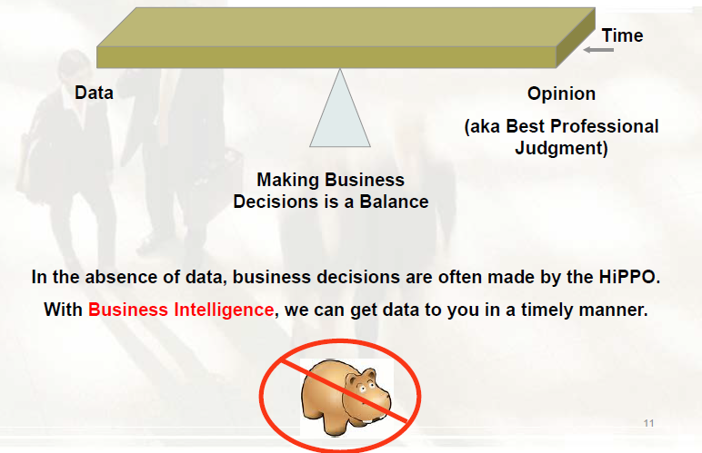
Why is BI So Important?

Slide 42
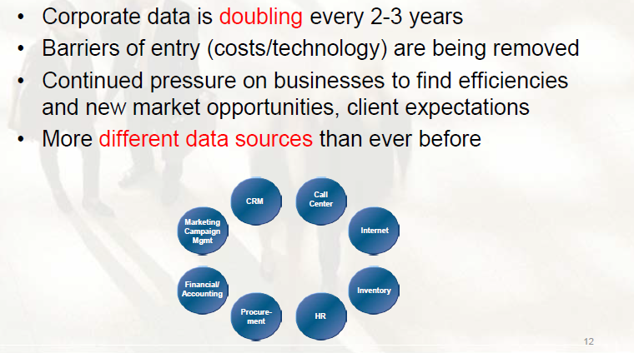
Why is BI So Important (Cont’)?

Slide 43
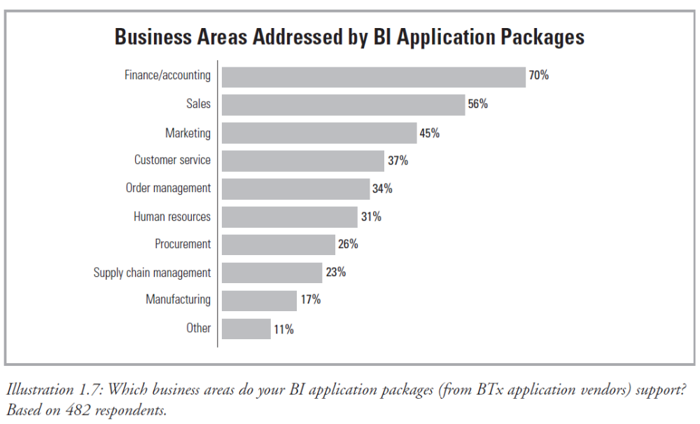
BI Business Areas
The Data Warehousing Institute (TDWI)

Slide 44
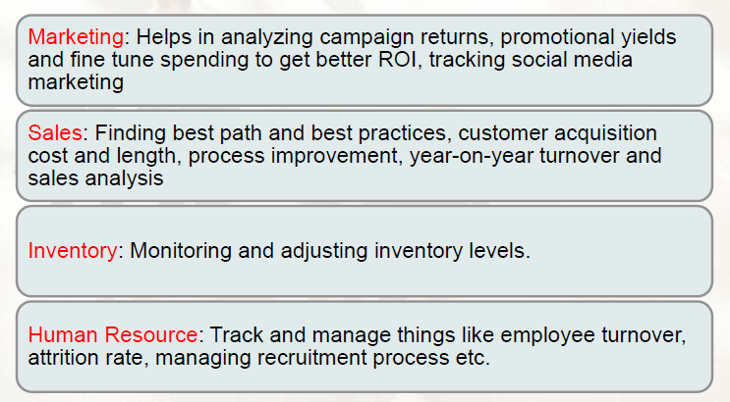
BI Business Areas (examples)

Slide 45
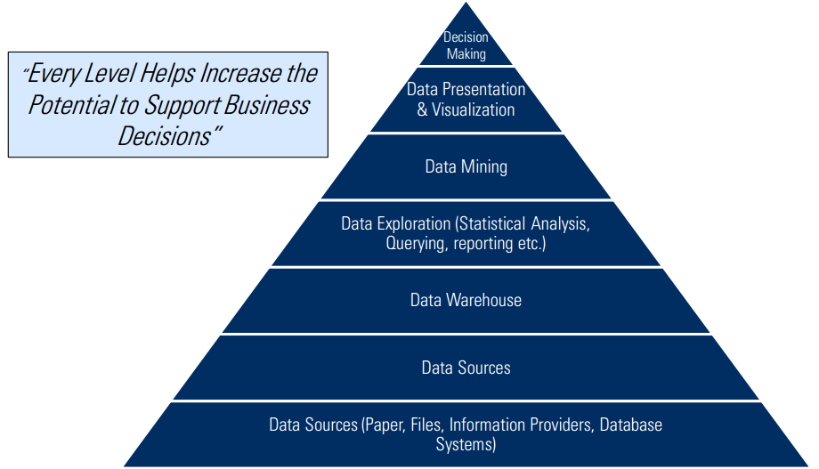
Business Intelligence Process
The key aspect of BI is Data Warehouse and Data Mining since data in BI is synthesized data.
Data Warehouse is characterized by various sources and formats, and it is clustering and historical.

Slide 46
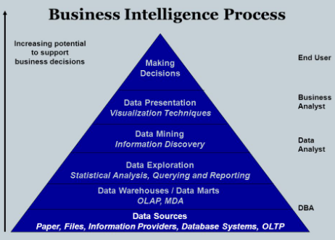
Besides, analyzing data in BI is not simple (query, Filtering), but it uses Data Mining technique to do classification, clustering, or prediction.
Thus, BI has a very tight relationship with Data Warehouse and Data mining.

Slide 47
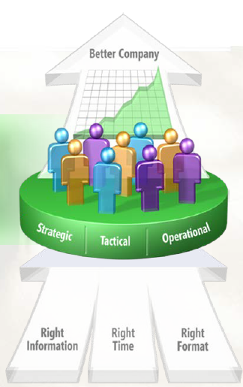
BI Strategy
Improving organizations by providing business insights to all employees leading to better, faster, more relevant decisions.
Allow business users the ability to query and write reports
To simplify reporting across multiple transaction systems
To store historical data longer than you can/would in transaction system

Slide 48
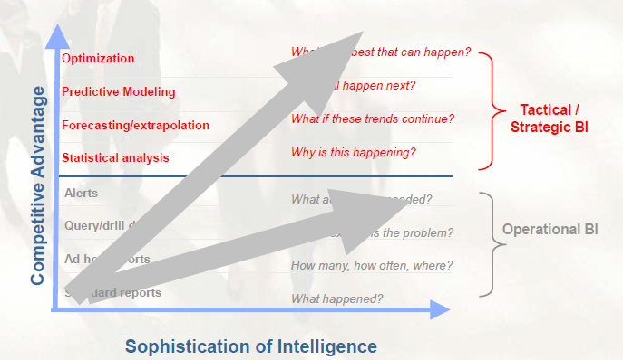
Why do companies need BI?
Alerts
What actions are needed?
Query/drill down
Where exactly is the problem?
Ad hoc reports
How many, how often, where?
Standard reports
What happened?

Slide 49
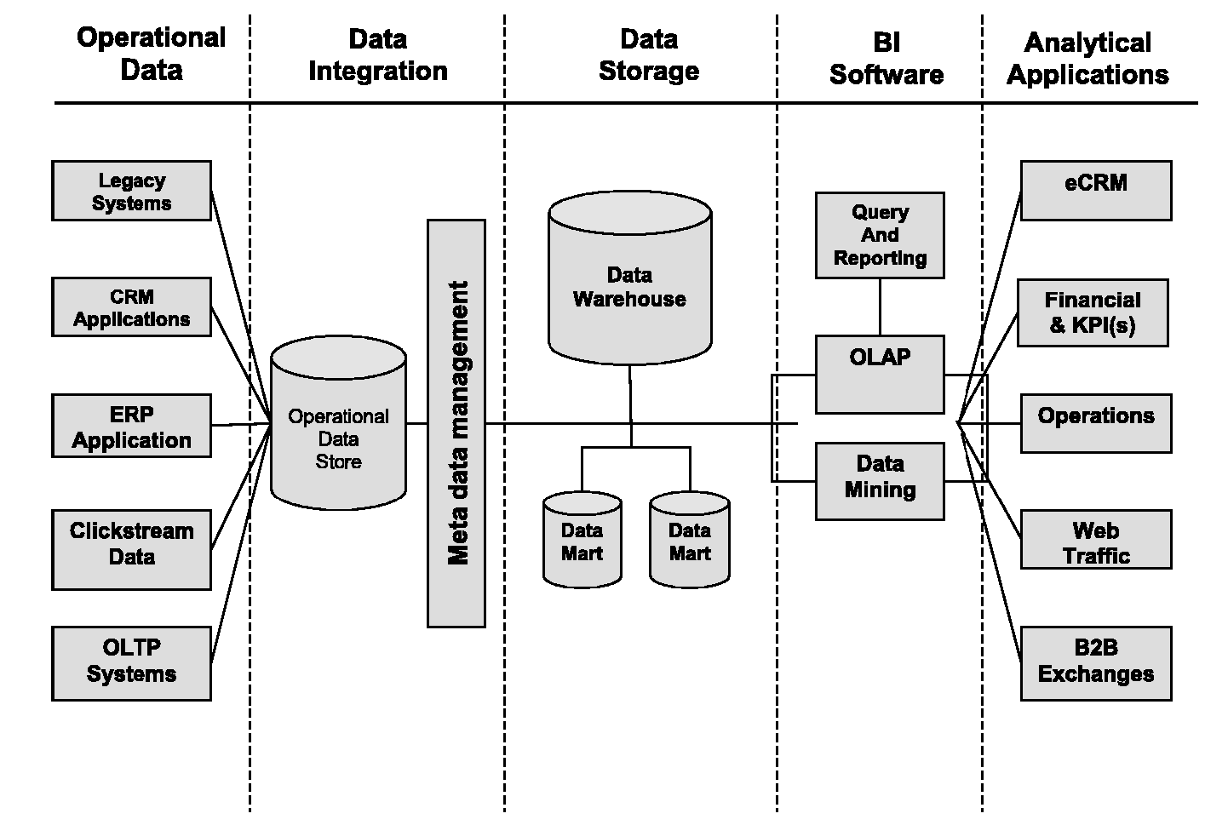
Business Intelligence Components

Slide 50
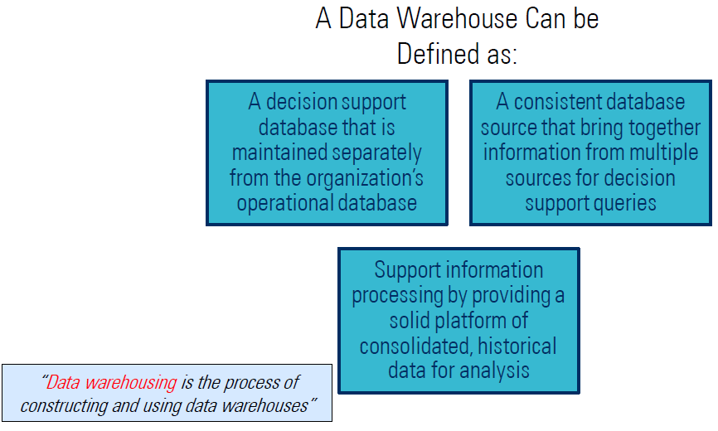
Data Warehouse
A data warehouse is a subject-oriented, integrated, time-variant and non-volatile collection of data in support of management decision making process.

Slide 51
OLTP – Online Transaction Processing
Online transaction processing, or OLTP, is a class of information systems that facilitate and manage transaction-oriented applications, typically for data entry and retrieval transaction processing.
Online transaction processing increasingly requires support for transactions that span a network and may include more than one company.

Slide 52
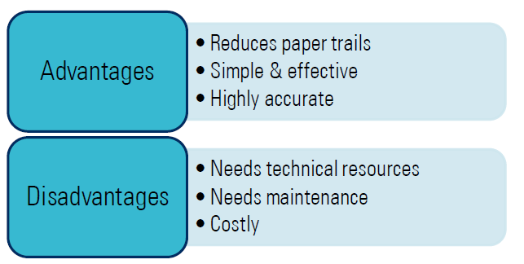
For this reason, new online transaction processing software uses client or server processing and brokering software that allows transactions to run on different computer platforms in a network.

Slide 53
OLAP – Online Analytical Processing
Online analytical processing, or OLAP is an approach to answering multi-dimensional analytical (MDA) queries swiftly.
OLAP tools enable users to analyze multidimensional data interactively from multiple perspectives.
OLAP consists of three basic analytical operations: consolidation (roll-up), drill-down, and slicing and dicing.

Slide 54
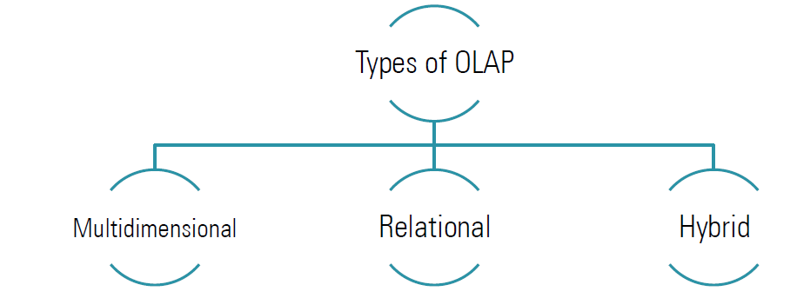
Consolidation involves the aggregation of data that can be accumulated and computed in one or more dimensions.

Slide 55
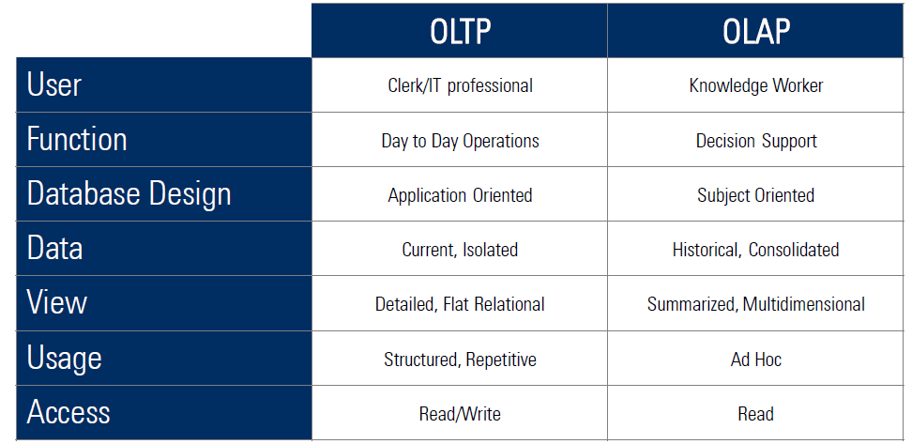
OLAP Vs. OLTP

Slide 56
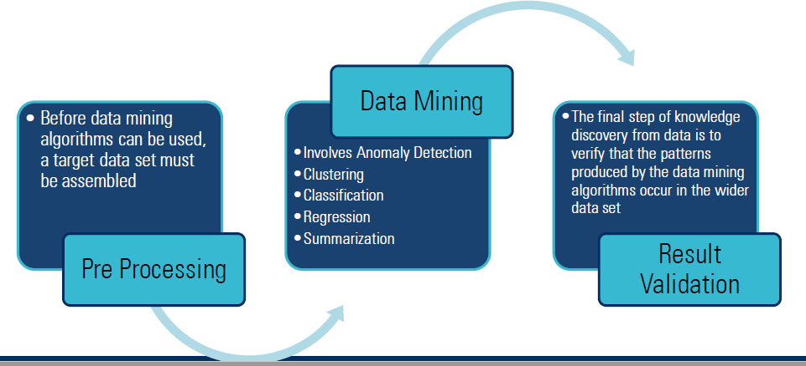
Data Mining & it’s Process
Data Mining is the computational process of discovering patterns in large data sets involving methods at the intersection of artificial intelligence, machine learning, statistics, and database systems.

Slide 57
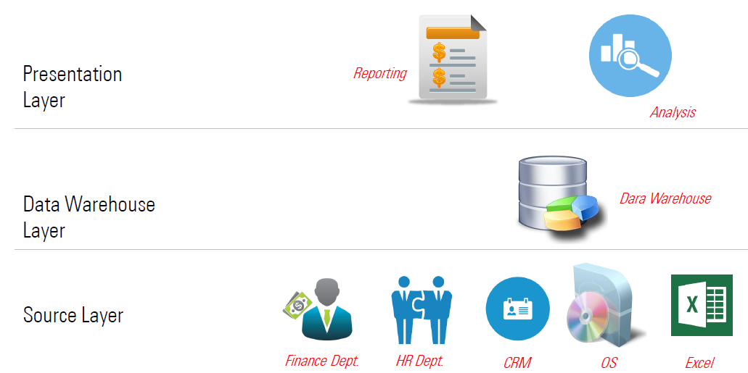
Business Intelligence Layers

Slide 58
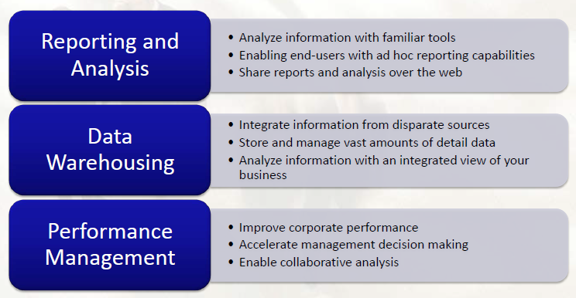
BI Types

Slide 59
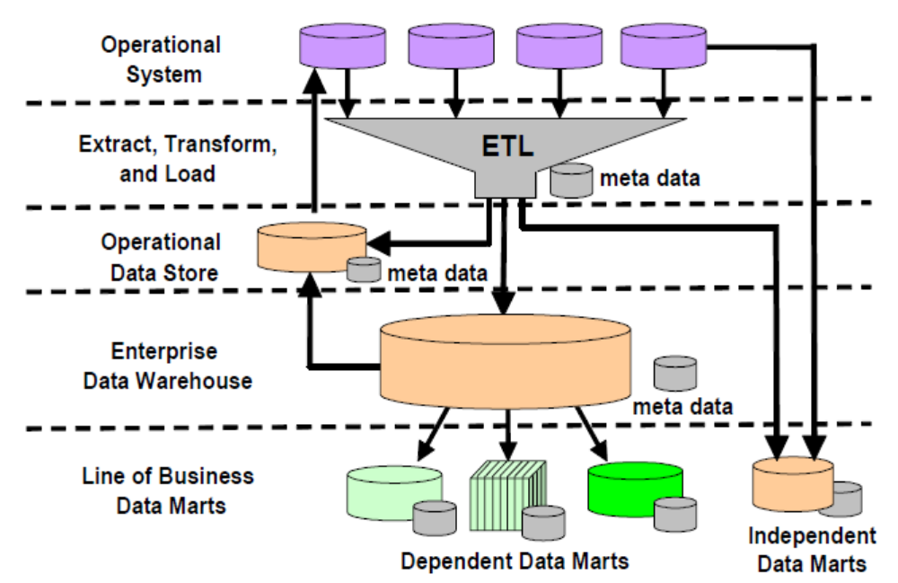
BI Architecture

Slide 60
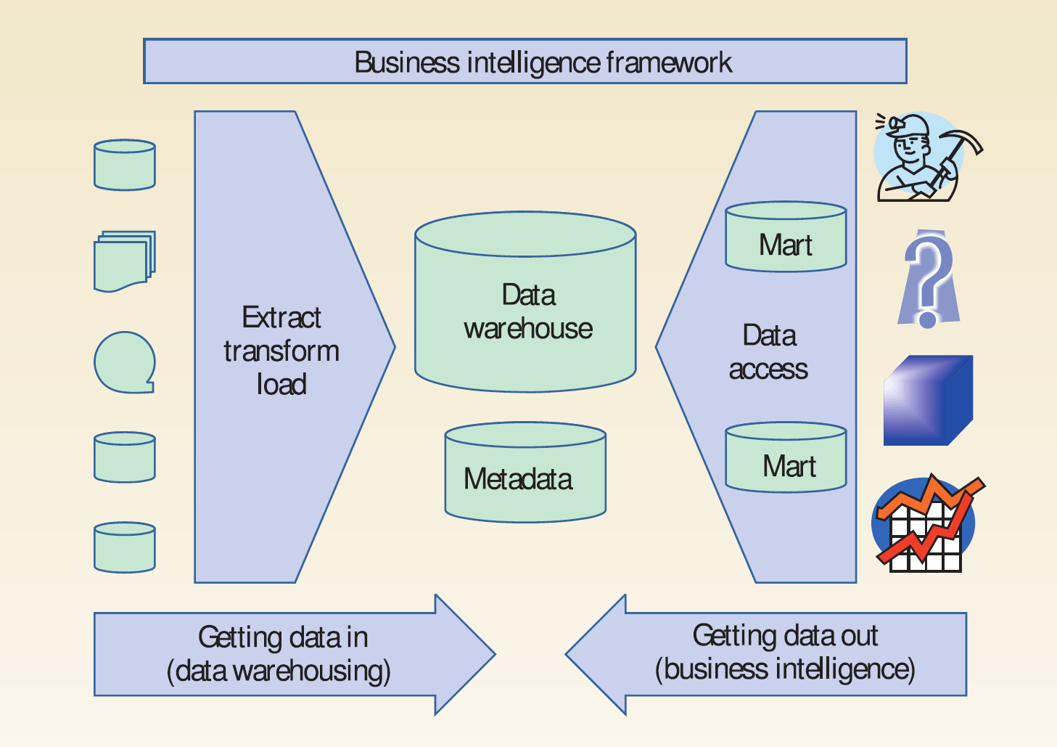
BI framework
(ETL)

Slide 61
A Framework for Business Intelligence (BI)
Business intelligence (BI)
A conceptual ( umbrella) framework for decision support.
It combines architecture, databases (or data warehouse), analytical tools and applications .
BI Objective: enable interactive access to data to enable manipulation of data and to give business managers to take a good decision.

Slide 62
A Framework for Business Intelligence (BI) cont’
The process of BI is based on the transformation of data to information, then to decisions, and finally to actions.

Slide 63
A Framework for Business Intelligence (BI) cont’
Benefits of BI
Time savings
Single version of truth
Improved strategies and plans
Improved tactical decisions
More efficient processes
Cost savings
Faster, more accurate reporting
Improved decision making
Improved customer service
Increased revenue
Many benefits are intangible

Slide 64
A Framework for Business Intelligence (BI) cont’
The Business Value of BI
  How BI Can Help
    Assess the readiness for meeting the challenges posed by these new business realities
    Take a holistic approach to BI functionality
    Leverage best practices and anticipate hidden costs

Slide 65
A Framework for Business Intelligence (BI) cont’
The Business Value of BI
  Key Issues and Framework for BI Analysis
    How can enterprises maximize their BI investments?
    What BI functionality do enterprises need, and what are they using today?
    What are some of the hidden costs associated with BI initiatives?

